Slide 1
Introduction to Flutter
Module: UI Design, Lecture #1

Slide 2
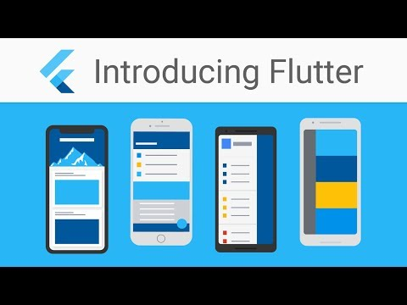

Slide 3
Flutter
By the end of the course, you will have the basic knowledge required to build such beautiful apps.
You will have the knowledge of a full stack Flutter developer, able to develop stand alone apps for Android and IOS.
Excited to get started? Great! Complete the initial setup following this guide: https://flutter-ko.dev/get-started/install/windows
Next, say hello to your new best friend, Flutter Widget.

Slide 4
Widgets

Slide 5
Widgets
Each element on a screen of the Flutter app is a widget.
Each flutter app is built by placing widgets over widget, just like we place lego block over lego blocks.
Placing widgets over widgets over widgets create a tree of widgets.

Slide 6
Let’s build our first app this way

Slide 7

Hello World
Let’s delete everything until we have just this.
The main function is where it all starts.
The MaterialApp widget tells that we want to build an app that follows the material design.

Slide 8
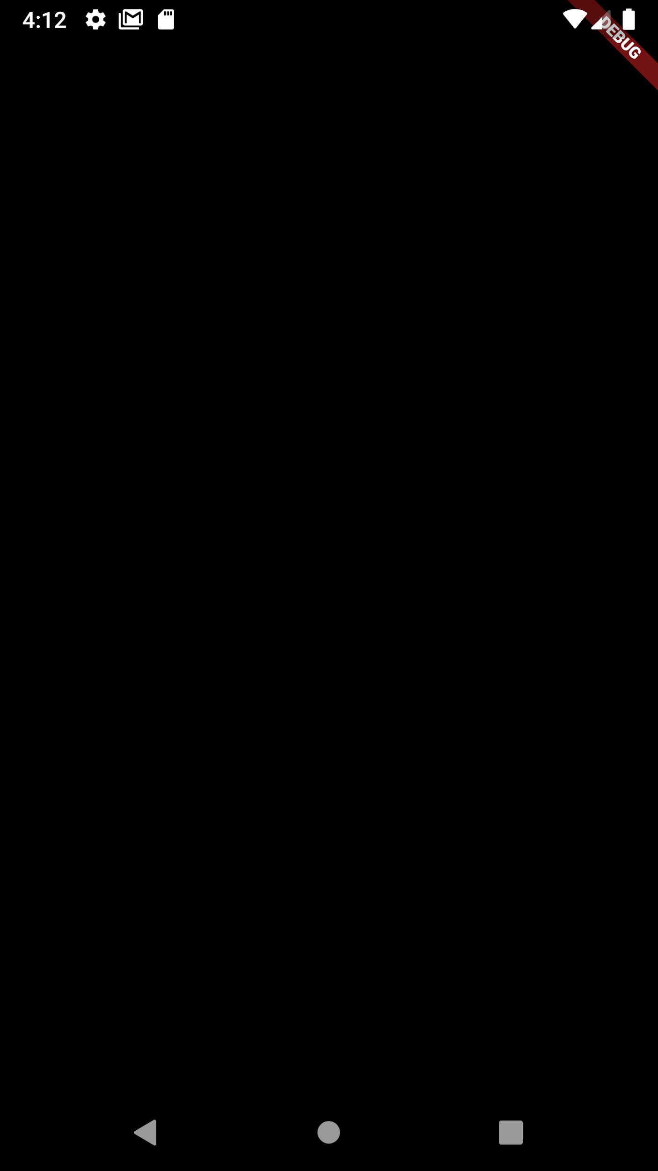
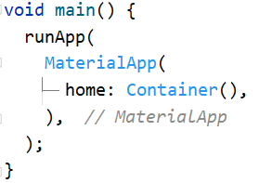
Hello World
We add an empty container widget as the homepage. Here ‘home’ is a named, optional parameter of Material App’s constructor.
Top tip: You must place a comma after every closing first bracket. This way, your code will be auto formatted upon every save

Slide 9
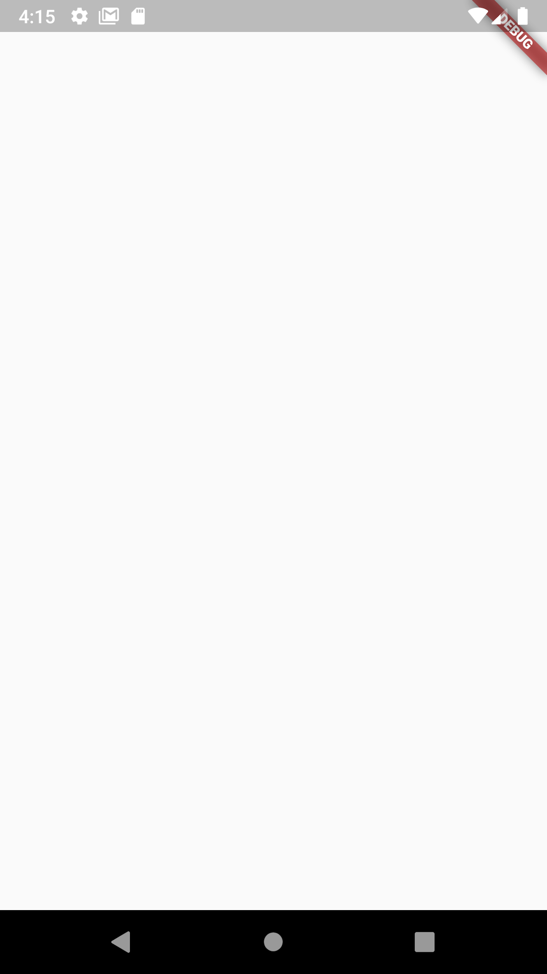
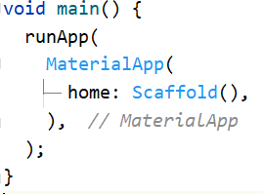
Hello World
Adding an empty container does nothing much. We need to add a Scaffold widget. Its function is to, you guessed it, literally be a scaffold to the entire app.

Slide 10
Scaffold
Scaffold is a widget in flutter -
It provides a framework to implement the basic material design layout of the application.
It provides API to set appbar, drawer, snackbar, bottom navigation bar, etc.
Scaffold will expand and occupy the entire screen.
Now that we have the scaffolding, we can build the entire app over it.

Slide 11
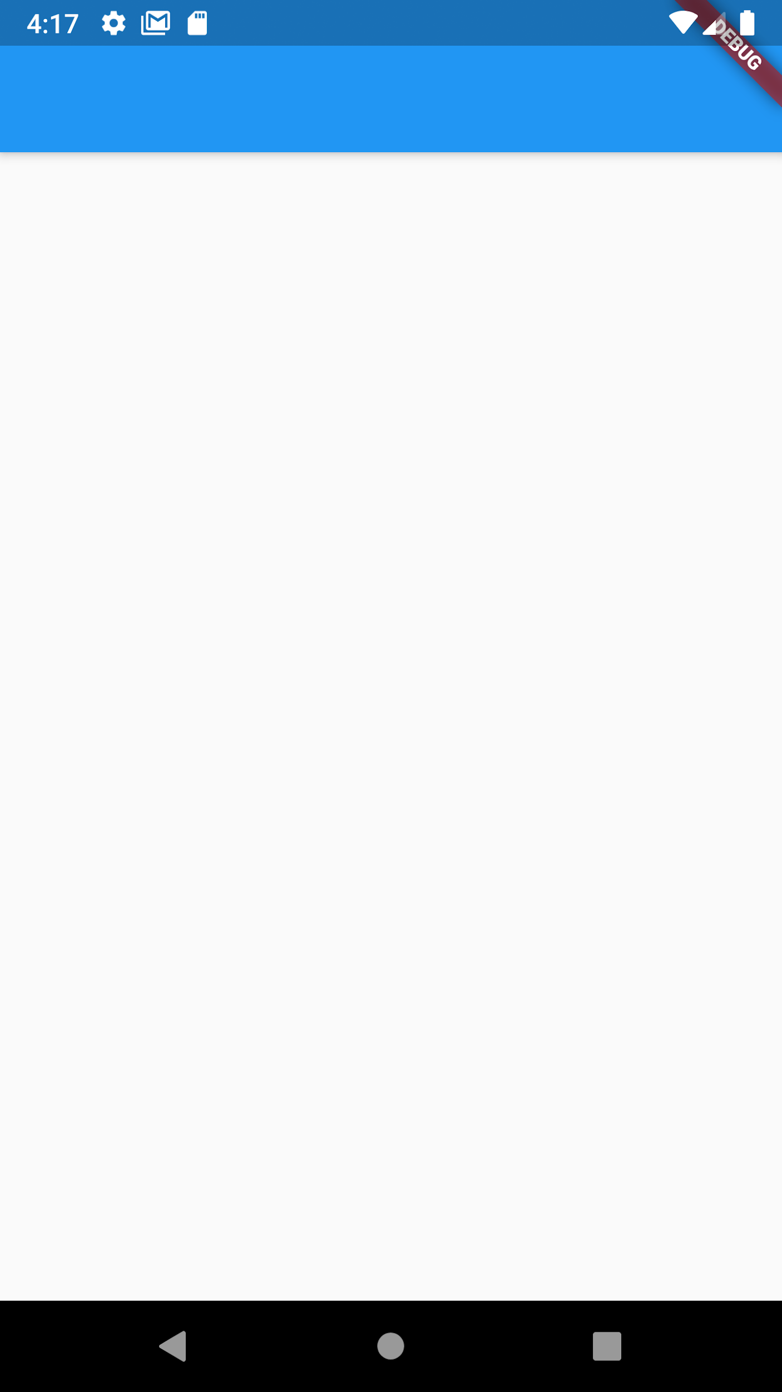
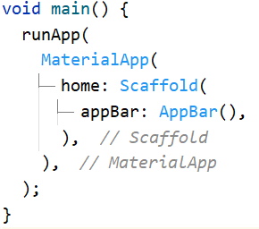
Hello World
The appBar property does the trick. But it looks empty, doesn’t it?

Slide 12
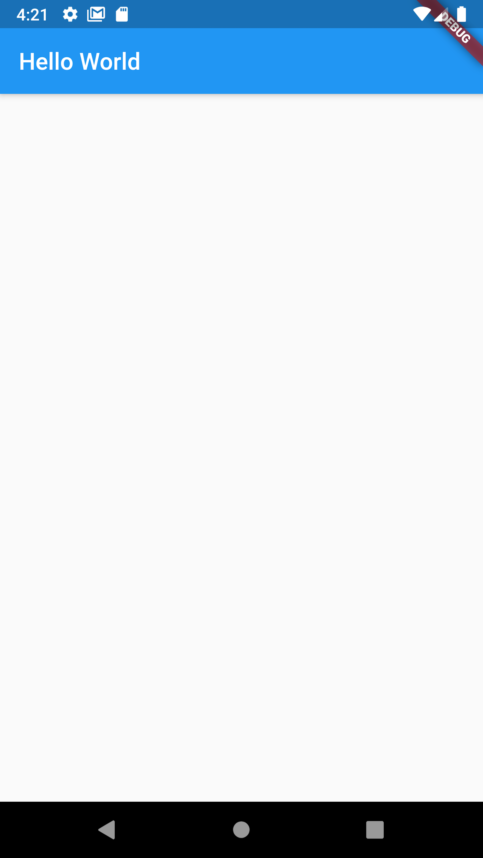
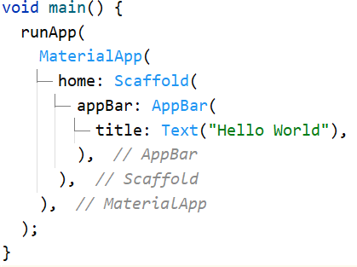
Hello World
The app bar needed a title. The title’s a Text widget.
Let’s add something to the body.

Slide 13
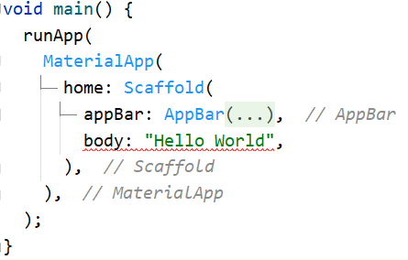
Hello World
Adding a string like this does not work. We need to add widgets only.

Slide 14
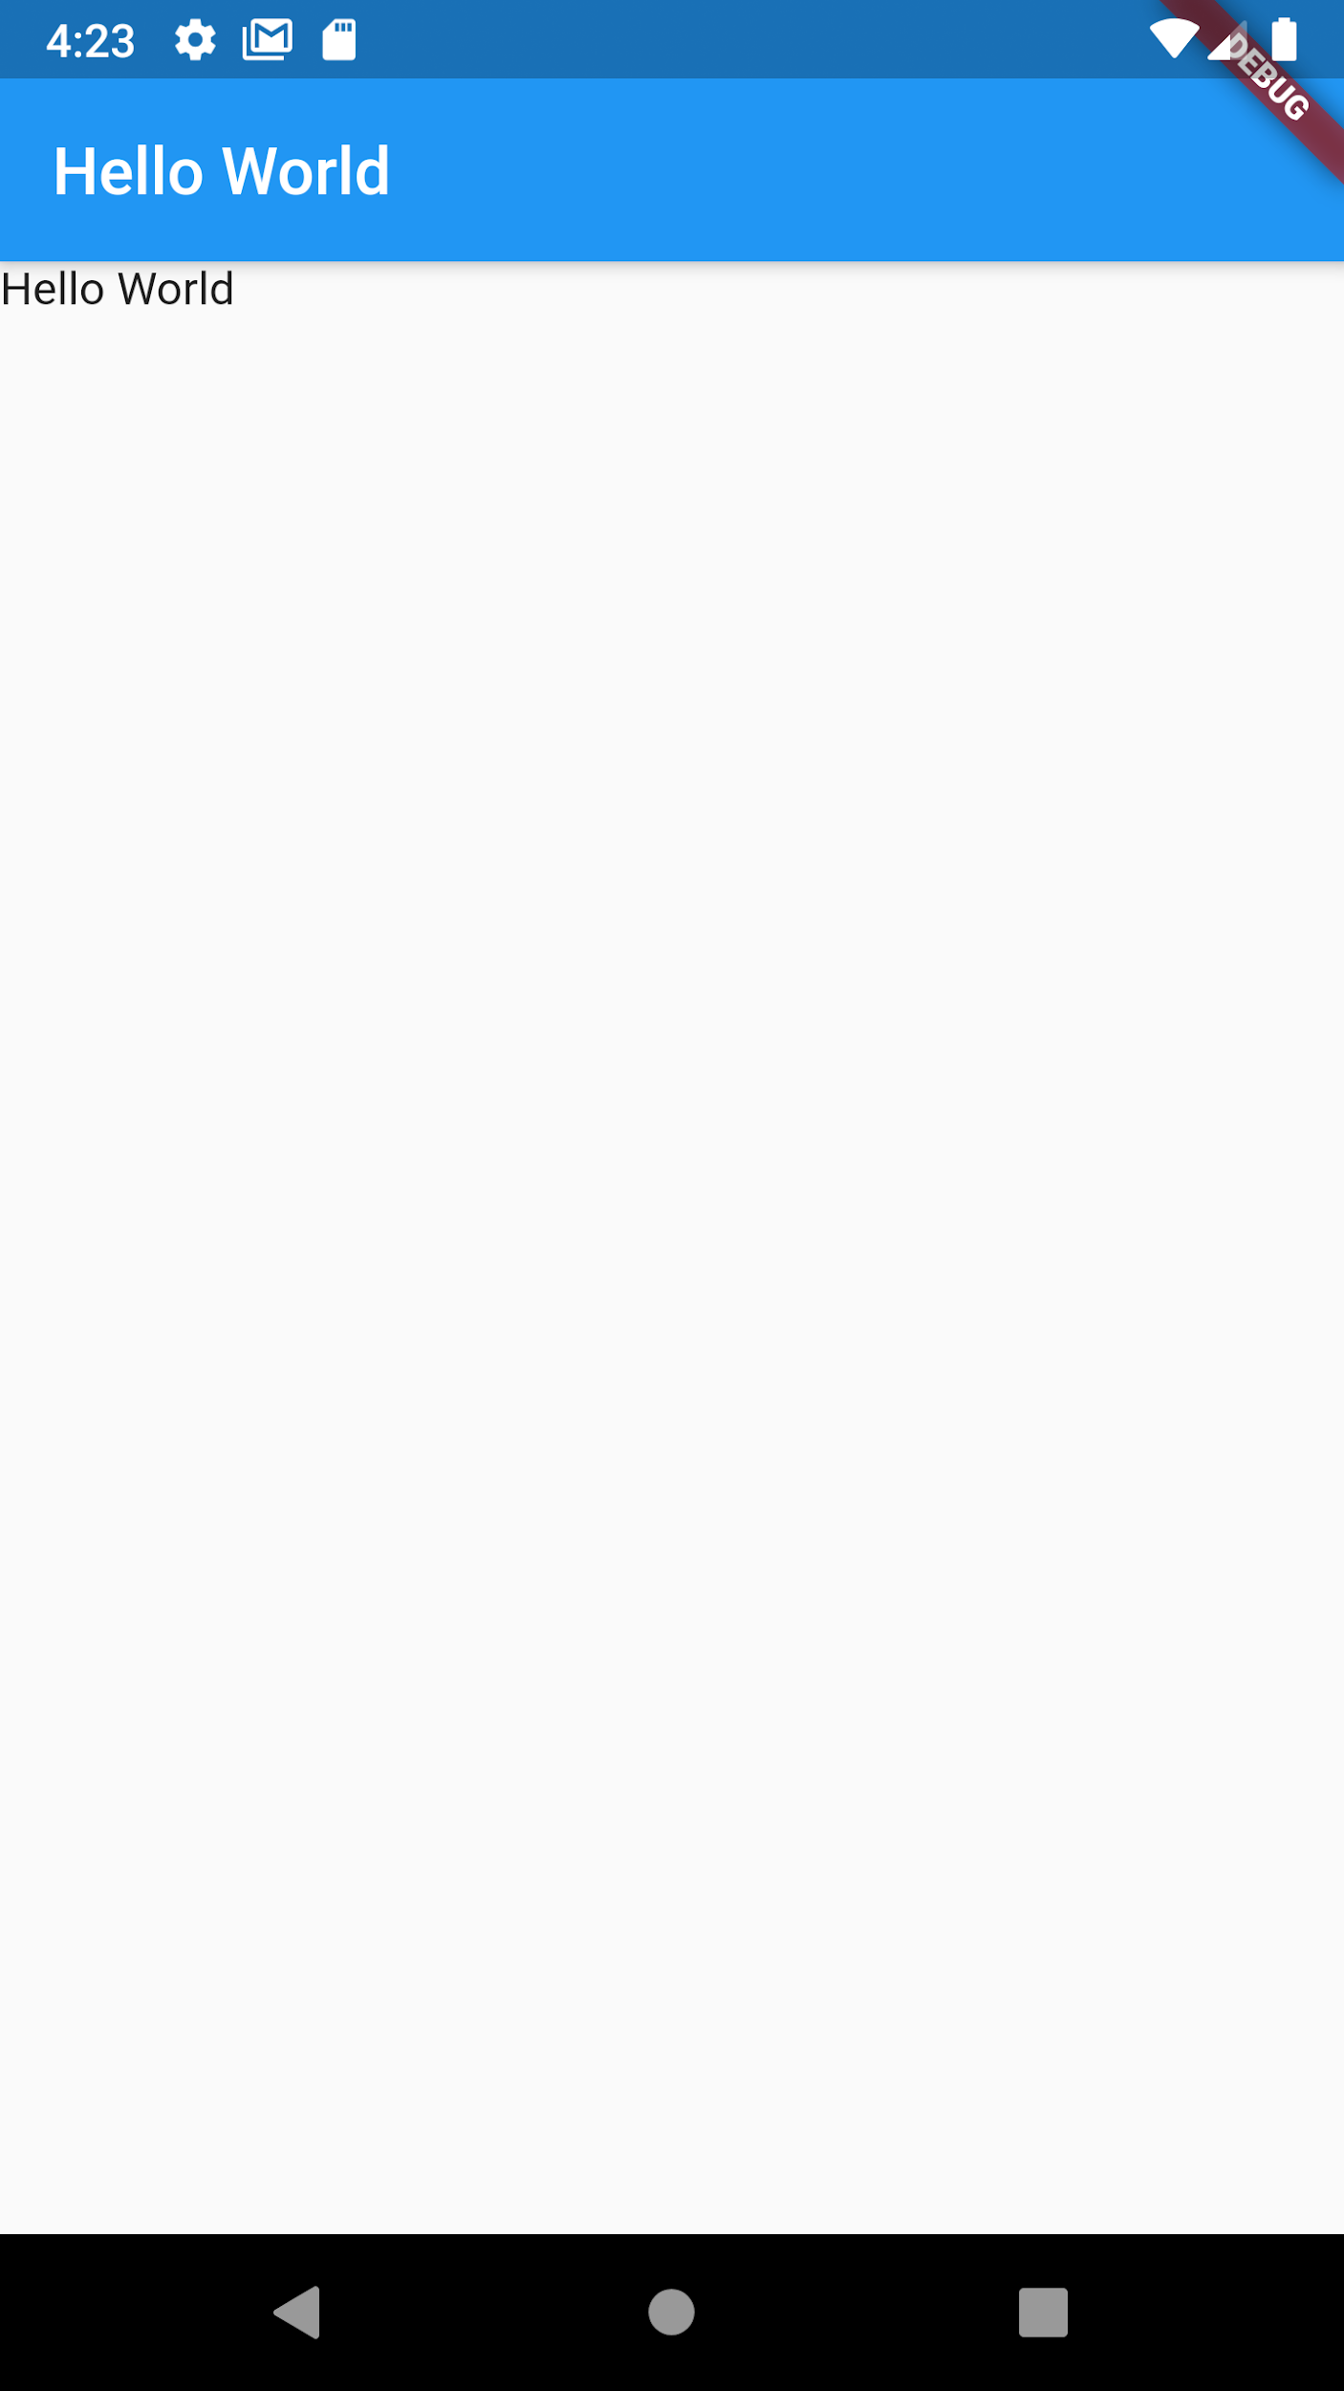
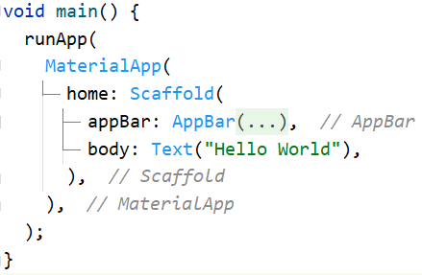
Hello World
There. That does it.
Widgets are normally added from the top left.

Slide 15
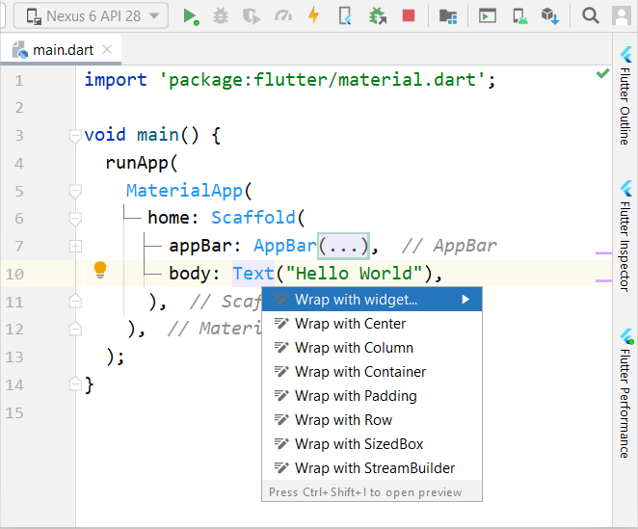
Hello World
Let’s try to center the text. And for that we use the Center widget.
Select the text widget and press alt+enter.
Select wrap with widget, and type “Center”

Slide 16
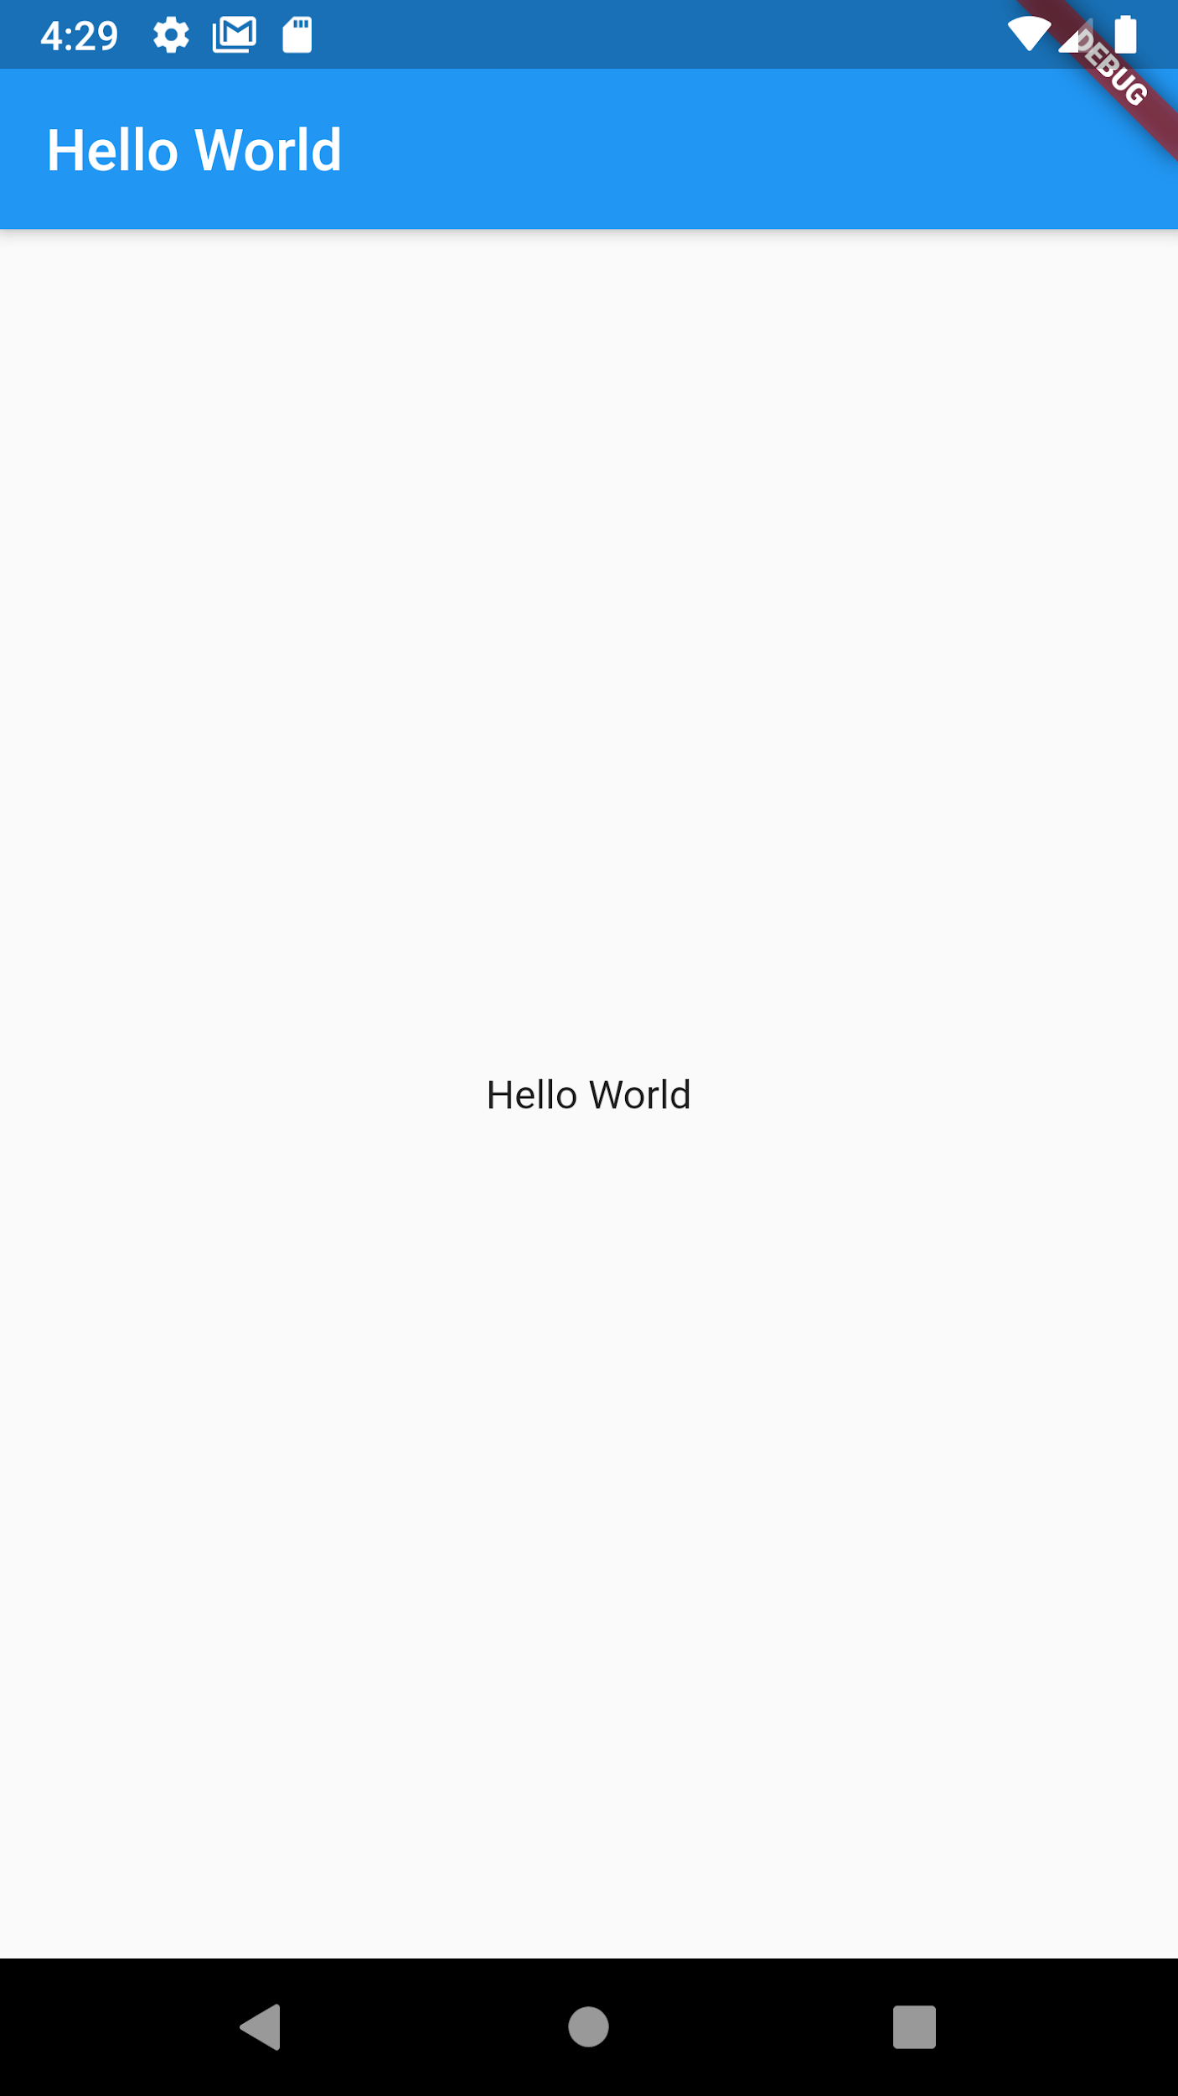
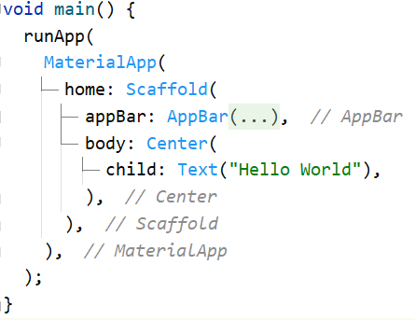
Hello World
Done.

Slide 17
Hello World
But the text looks too small doesn’t it?
Let’s try customizing the text widget. For that, we use textStyle widget.

Slide 18
So how do we find its details?

Slide 19
Quick documentation
For details, we always refer to flutter documentation.
Google search the name of the Widget and access the result from flutter’s official documentation site https://api.flutter.dev/
Alternatively, select the Widget in question in Android studio and press ctrl+q to view quick docs, as shown in the next slide
Or access one of the many guides on medium.com

Slide 20
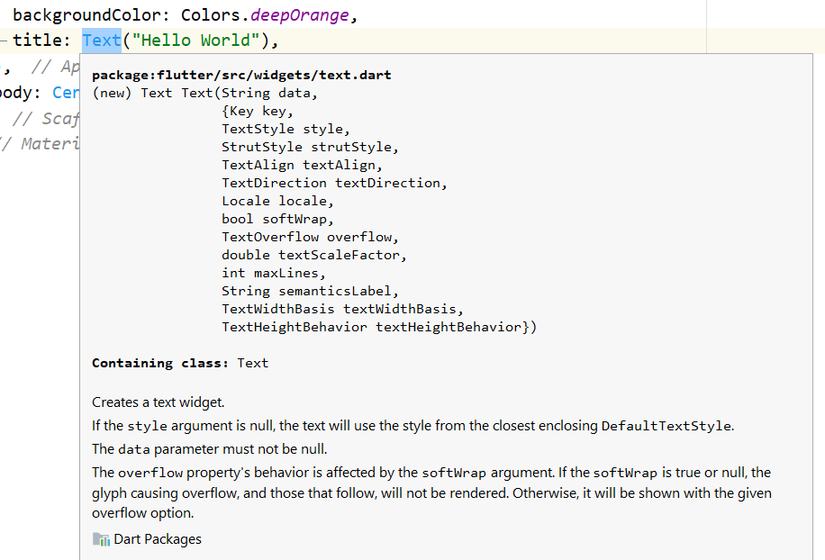
Quick documentation

Slide 21
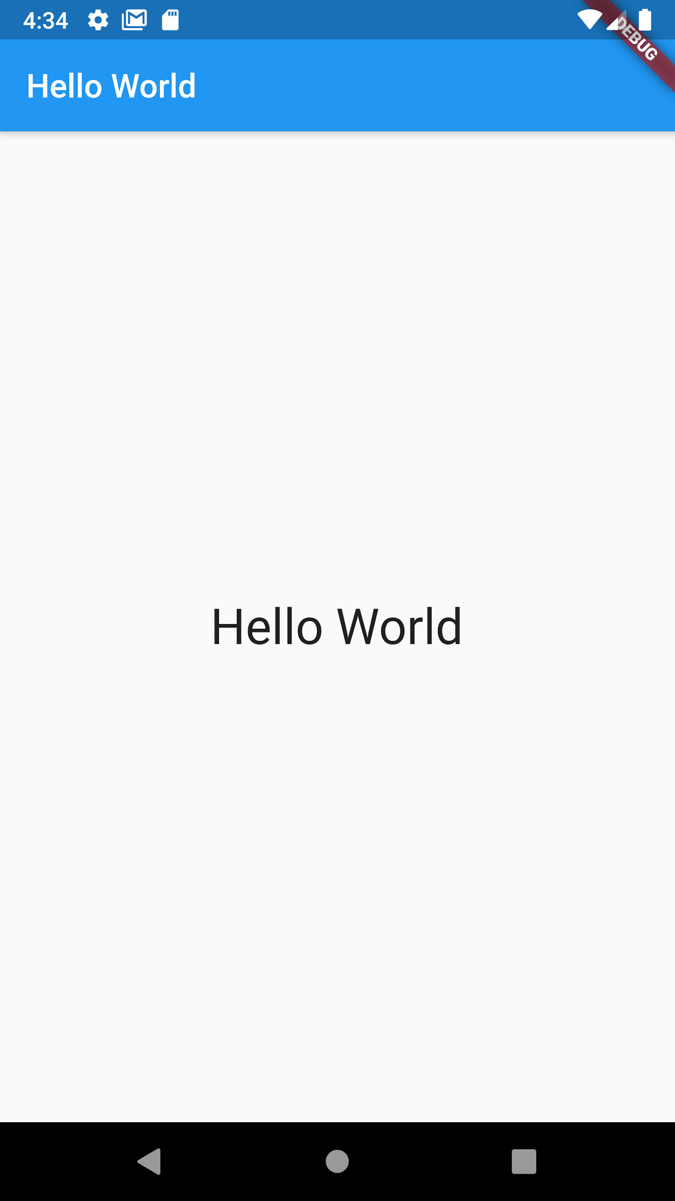
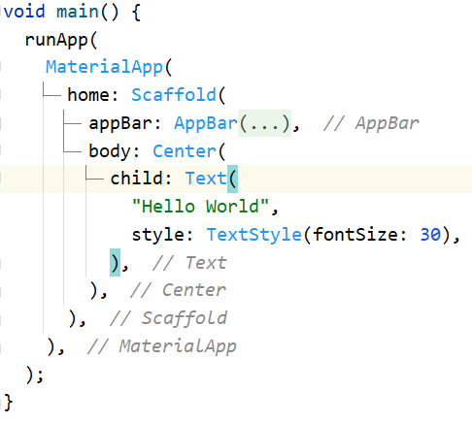
Hello World
Whichever way you use, you will see that TextStyle has a “fontsize” property.

Slide 22
Hello World
Similarly, can you change the color of the app bar?

Slide 23
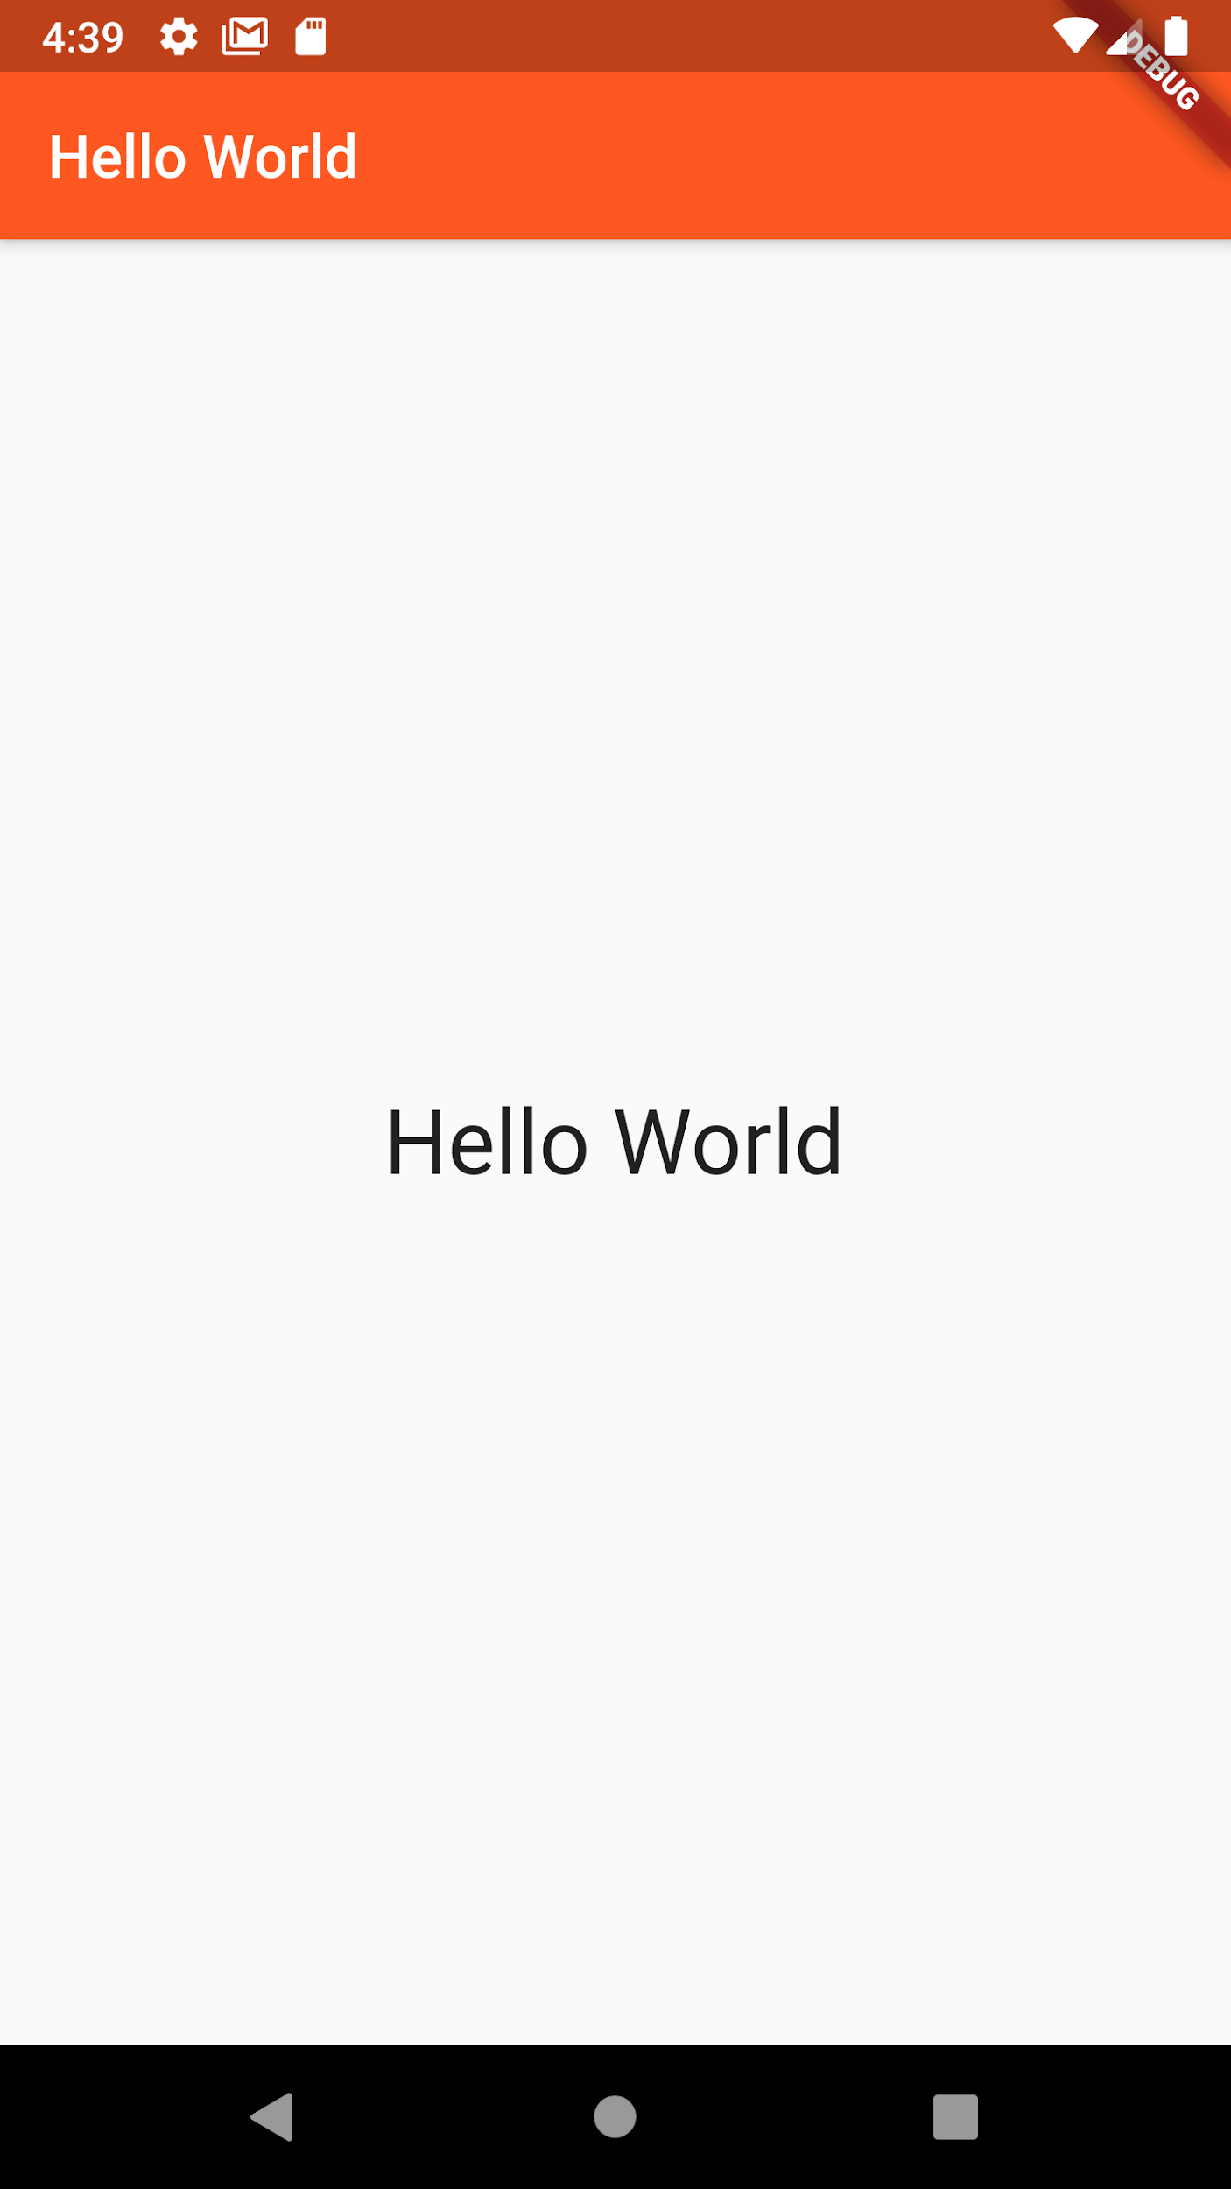
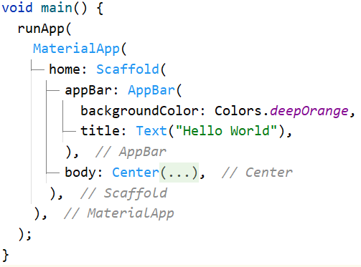
Hello World
Easy, when you know where to find the (quick) documentation.

Slide 24
But you want fancier colors, I hear?

Slide 25
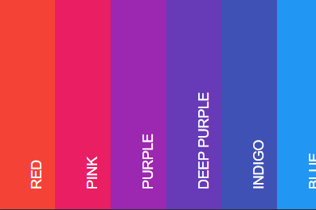
Color
For that, let's head over to https://www.materialpalette.com/colors
You will find all material colors here. Choose on one, and click on it.

Slide 26
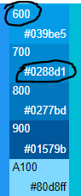

Color
You will see codes like this. You can either use:
The material color codes (like Blue 600 / 700)
The Hex codes (like #039be5 / #0288d1)
Or accent color codes which start with A (like A100/ A200 / A300)

Slide 27
Color
Here is how to use them:
color: Colors.blue[600]
color: Color(0xFF039be5). When using hex codes, this is the format - 0xFF followed by the copied code without the “#”
color: Colors.blueAccent[100]

Slide 28
Let’s try placing an image instead of text

Slide 29
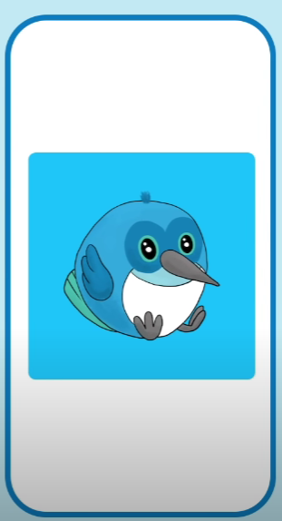
Image
To add an image, we use the “Image” widget.
There are different ways to add an image
From local image (asset image)
From the internet (network image)

Slide 30
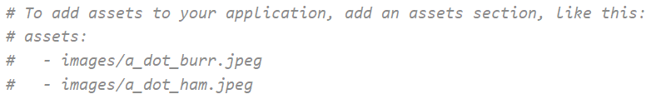
Asset Image
First, we need to add the image as dependency
For this, create an “assets” folder under your project root directory, and paste your image here.
Go to pubspec.yaml file (under project root directory) and search for this line:

Slide 31

Asset Image
Change to:
In “- assets/” the “assets” is the directory. “/” tells to load everything in this directory
Be very careful with indentation here. The “assets:” is preceded by two blank spaces and the next line is preceded by four.
When you are done, hit save

Slide 32
Asset Image
Click “pub get” to get all dependencies listed
When done, we can load asset images anywhere in app like this:
Just don’t forget to start with “assets/” since this is where your image is in.

Slide 33
Network Image
Or you can load you image from the internet. Obviously, the image won’t load as fast as asset image.

Slide 34
App Icon

Slide 35
Changing app icon
The manual way of changing app icon is a little boring to say the least.
Fortunately, there is a wide community of developers who contribute to improving flutter.
If you need anything generic, mostly probably it is something someone else has needed and is willing to share his solution with you.
The official platform for this is pub.dev.
Head over to pub.dev and search for what you need. In this case, search for “launcher icons”

Slide 36
Changing app icon
The manual way of changing app icon is a little boring to say the least.
Fortunately, there is a wide community of developers who contribute to improving flutter.
If you need anything generic, mostly probably it is something someone else has needed and is willing to share his solution with you.
The official platform for this is pub.dev.
Head over to pub.dev and search for what you need. In this case, search for “launcher icons”

Slide 37
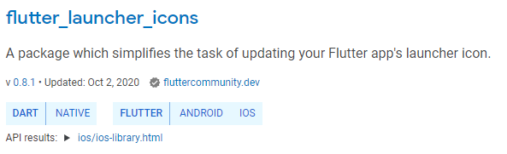
Changing app icon
Select flutter_launcher_icons

Slide 38
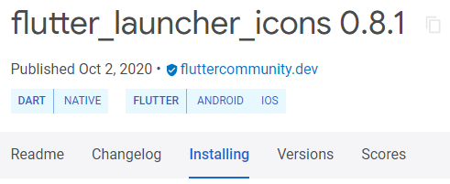
Changing app icon
Explore its documentation. Then go to “installing” tabs for how install it.

Slide 39

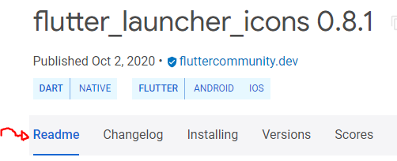
Changing app icon
Add to dependencies: flutter_launcher_icons: ^0.8.1
I always add dependencies under the line “cupertino icons”
Be very careful with the indentation. It must be aligned the same way as cupertino_icons
Then read its readme to learn how to use it.

Slide 40
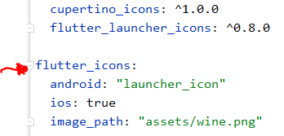
Changing app icon
According to the readme, add these here and in the same indentation
Change Image_path should to the correct path of your icon image.

Slide 41
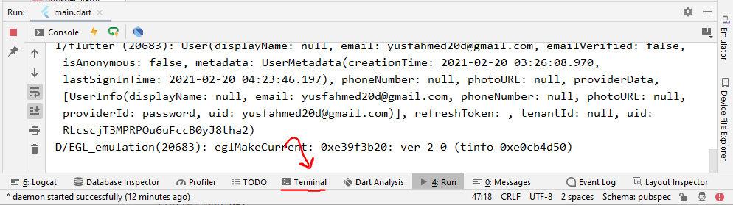
Changing app icon
Open a terminal

Slide 42

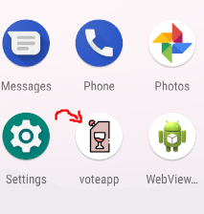
Changing app icon
And run these two commands -
And that’ it! You may have to reinstall the app for icon to work.

Slide 43
Boss level challenge

Slide 44
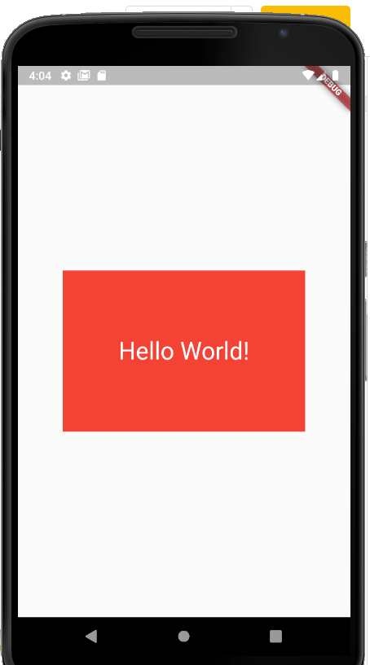
Challenge
Can you implement this UI?
Here we have a container in the center with some text in the center. The text color is white and the text size is 30. The red container is exactly 200 pixels in length and 300 pixels in width.
We haven’t yet discussed coloring and sizing containers or coloring text. But I encourage you to find that out yourself using the online docs or quick docs from android studio.
Change the app icon to anything you want

Slide 45
Thank you

